Slide 1
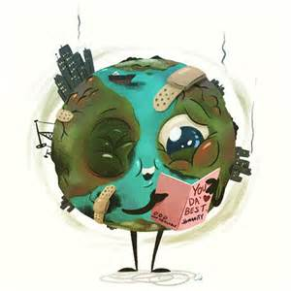
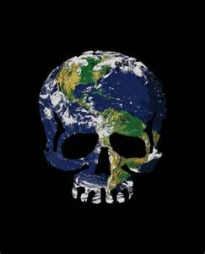
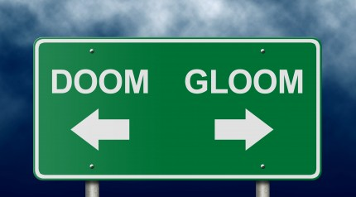
Chapter 56 – Conservation Biology and Global Change
Or humanity sucks…and a few ways to suck less

Slide 2
Section 56.1 – Human Activities threaten Earth’s Biodiversity
Rates of species extinction are difficult to determine under natural conditions
The high rate of species extinction is largely a result of ecosystem degradation by humans
Humans are threatening Earth’s biodiversity

Slide 3
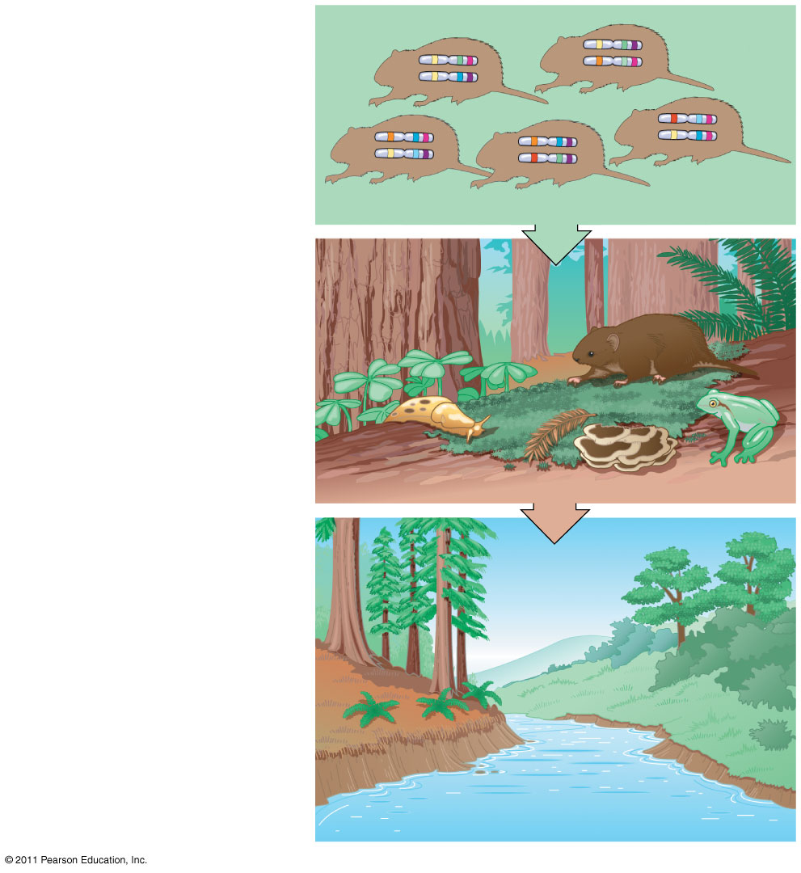
What is Biodiversity?
Genetic diversity
in a vole population
Biodiversity has three main components
Genetic diversity
Species diversity
Ecosystem diversity
Species diversity
in a coastal
redwood ecosystem
Community and
ecosystem diversity
across the
landscape of
an entire region

Slide 4
Species Diversity
According to the U.S. Endangered Species Act
An endangered species is “in danger of becoming extinct throughout all or a significant portion of its range”
A threatened species is likely to become endangered in the foreseeable future
Conservation biologists are concerned about species loss because of alarming statistics regarding extinction and biodiversity
Globally, 12% of birds, 20% of mammals, and 32% of amphibians are threatened with extinction
Extinction may be local or global

Slide 5
Ecosystem Diversity
Human activity is reducing ecosystem diversity, the variety of ecosystems in the biosphere
More than 50% of wetlands in the contiguous United States have been drained and converted to other ecosystems
The local extinction of one species can have a negative impact on other species in an ecosystem

Slide 6
Benefits of Species and Genetic Diversity
Species related to agricultural crops can have important genetic qualities
For example, plant breeders bred virus-resistant commercial rice by crossing it with a wild population
In the United States, 25% of prescriptions contain substances originally derived from plants
For example, the rosy periwinkle contains alkaloids that inhibit cancer growth
The loss of species also means loss of genes and genetic diversity

Slide 7
Ecosystem Services
Ecosystem services encompass all the processes through which natural ecosystems and their species help sustain human life
Some examples of ecosystem services
Purification of air and water
Detoxification and decomposition of wastes
Cycling of nutrients
Moderation of weather extremes

Slide 8
Threats to Biodiversity
Most species loss can be traced to four major threats
Habitat destruction
Introduced species
Overharvesting
Global change

Slide 9
Habitat Loss
Human alteration of habitat is the greatest threat to biodiversity throughout the biosphere
In almost all cases, habitat fragmentation and destruction lead to loss of biodiversity
For example
In Wisconsin, prairie occupies <0.1% of its original area
About 93% of coral reefs have been damaged by human activities

Slide 10
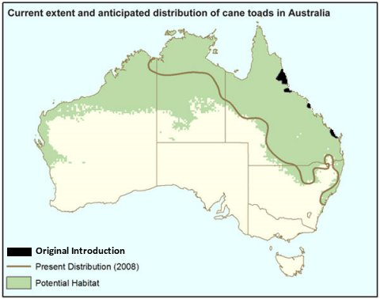
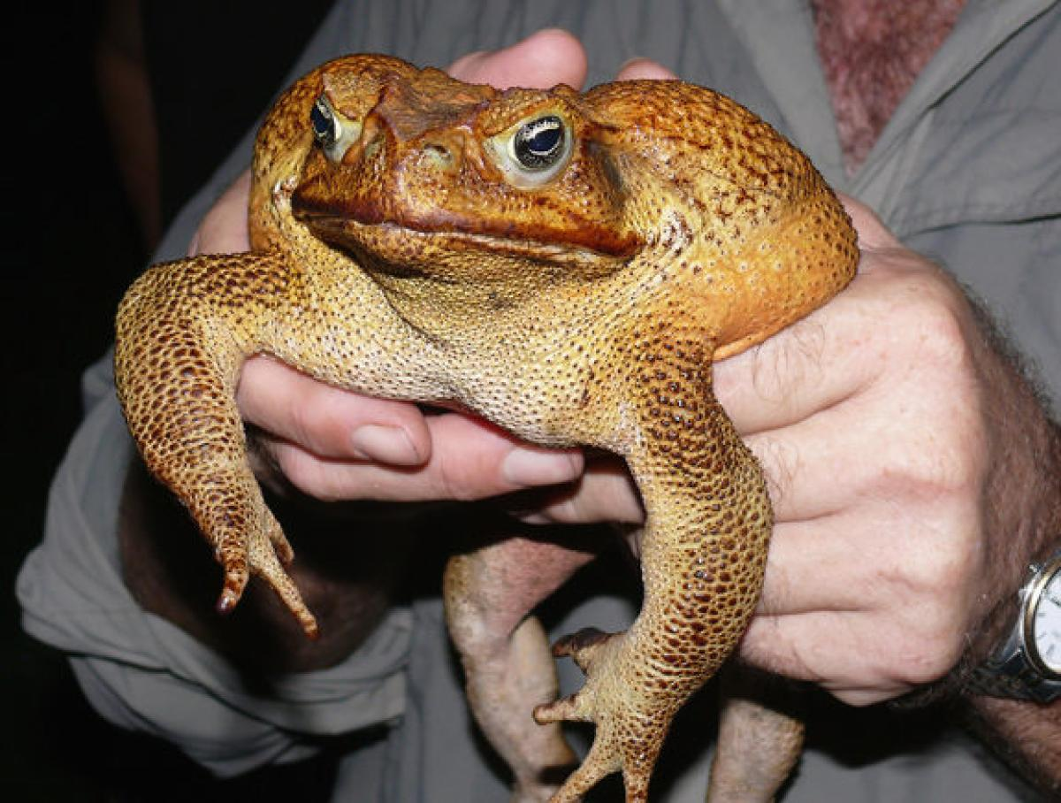
Introduced/Invasive Species
Introduced species are those that humans move from native locations to new geographic regions
Without their native predators, parasites, and pathogens, introduced species may spread rapidly
Introduced species that gain a foothold in a new habitat usually disrupt their adopted community

Slide 11
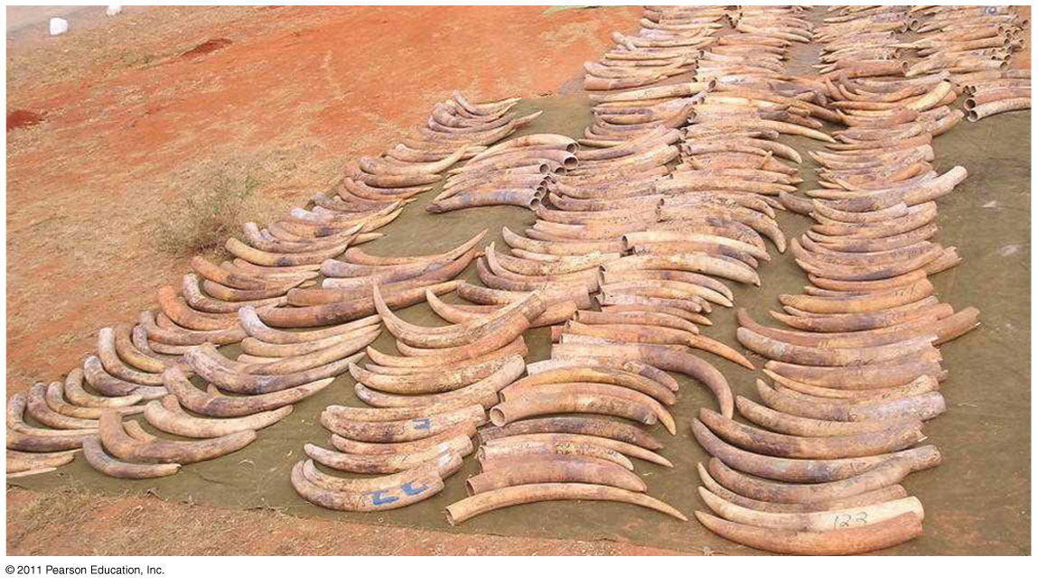
Overharvesting
Overharvesting is human harvesting of wild plants or animals at rates exceeding the ability of populations of those species to rebound
Large organisms with low reproductive rates are especially vulnerable to overharvesting
For example, elephant populations declined because of harvesting for ivory
Overfishing has decimated wild fish populations
For example, the North Atlantic bluefin tuna has decreased by 80% in ten years

Slide 12
Global Change
Global change includes alterations in climate, atmospheric chemistry, and broad ecological systems
Acid precipitation contains sulfuric acid and nitric acid from the burning of wood and fossil fuels
Air pollution from one region can result in acid precipitation downwind
For example, industrial pollution in the midwestern United States caused acid rain in eastern Canada in the 1960s
Acid precipitation kills fish and other lake-dwelling organisms
Environmental regulations have helped to decrease acid precipitation

Slide 13
Section 56.2: Population conservation focuses on population size, genetic diversity, and critical habitat
Biologists focusing on conservation at the population and species levels follow two main approaches
The small-population approach
The declining-population approach

Slide 14
Small Population Approach
The small-population approach studies processes that can make small populations become extinct

Slide 15
Minimum Viable Population Size
Minimum viable population (MVP) is the minimum population size at which a species can survive
The MVP depends on factors that affect a population’s chances for survival over a particular time

Slide 16
Effective Population Size
A meaningful estimate of MVP requires determining the effective population size, which is based on the population’s breeding potential
Effective population size N_{e} is estimated by
where N_{f} and N_{m} are the number of females and the number of males, respectively, that breed successfully
4N_{f}N_{m}
N_{e} =
N_{f} + N_{m}

Slide 17
Declining Population Approach
The declining-population approach
Focuses on threatened and endangered populations that show a downward trend, regardless of population size
Emphasizes the environmental factors that caused a population to decline

Slide 18
Steps for Analysis and Intervention
The declining-population approach involves several steps
Confirm that the population is in decline
Study the species’ natural history
Develop hypotheses for all possible causes of decline
Test the hypotheses in order of likeliness
Apply the results of the diagnosis to manage for recovery

Slide 19
Weighing Conflicting Demands
Conserving species often requires resolving conflicts between habitat needs of endangered species and human demands
For example, in the U.S. Pacific Northwest, habitat preservation for many species is at odds with timber and mining industries
Managing habitat for one species might have positive or negative effects on other species

Slide 20
Section 56.3: Landscape and regional conservation help sustain biodiversity
Conservation biology has attempted to sustain the biodiversity of entire communities, ecosystems, and landscapes
Ecosystem management is part of landscape ecology, which seeks to make biodiversity conservation part of land-use planning

Slide 21
Landscape Structure and Biodiversity
Fragmentation and Edges
The boundaries, or edges, between ecosystems are defining features of landscapes
Some species take advantage of edge communities to access resources from both adjacent areas
Landscapes dominated by fragmented habitats support fewer species due to a loss of species adapted to habitat interiors
Corridors
A movement corridor is a narrow strip of quality habitat connecting otherwise isolated patches
Movement corridors promote dispersal and help sustain populations
In areas of heavy human use, artificial corridors are sometimes constructed

Slide 22
Preserving Biodiversity Hot Spots
A biodiversity hot spot is a relatively small area with a great concentration of endemic species and many endangered and threatened species
Designation of hot spots is often biased toward saving vertebrates and plants
Hot spots can change with climate change

